Slide 1
Goodwill Industries of St. Clair County

Slide 2
Our Mission
GW’s Mission is to support and honor the worth of everyone in our community –that includes the Earth!!

Slide 3
The idea of being green, and our message of environmental sustainability, has always been an underlying philosophy of our business. At Goodwill we are happy to boast that we’re one of the greenest organizations on the planet.

Slide 4
Goodwill was founded in 1902 in Boston by Rev. Edgar J. Helms, a Methodist minister and early social innovator. Helms collected used household goods and clothing in wealthier areas of the city, then trained and hired those who were poor to mend and repair the used goods.

Slide 5
Through Your Donations to Goodwill We Have Been Able to:
Divert nearly 2,000,000 pounds of textiles, plastic, metal, glass, electronics from entering our local landfill.
This is done while providing over 150,000 hours of workforce training.

Slide 6
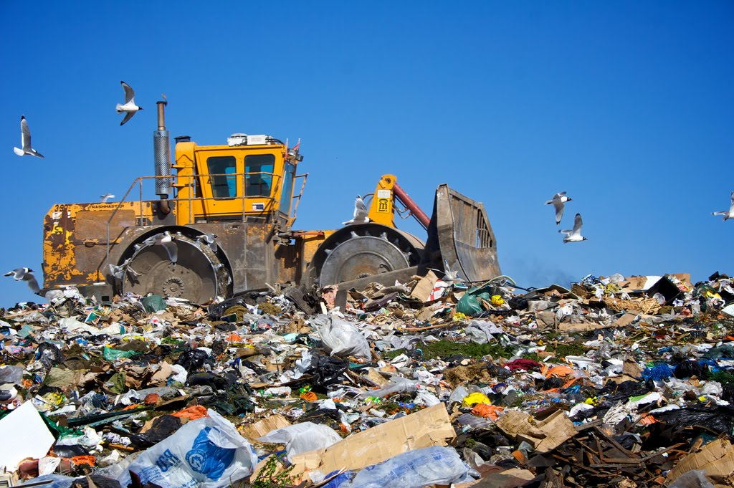
Goodwill’s Goal is Zero Waste
Last Year Alone Goodwill Reduced It’s Waste to Landfills By 63%

Slide 7
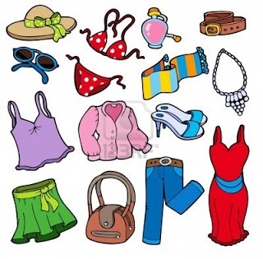
Every year individuals throw out over 70 pounds of clothing that can be donated and kept from a landfill!

Slide 8
Would You Buy This??

Slide 9
Would You Donate This to Goodwill?? (Would your Mother be embarrassed)

Slide 10
Would You Throw This In The Trash??

Slide 11
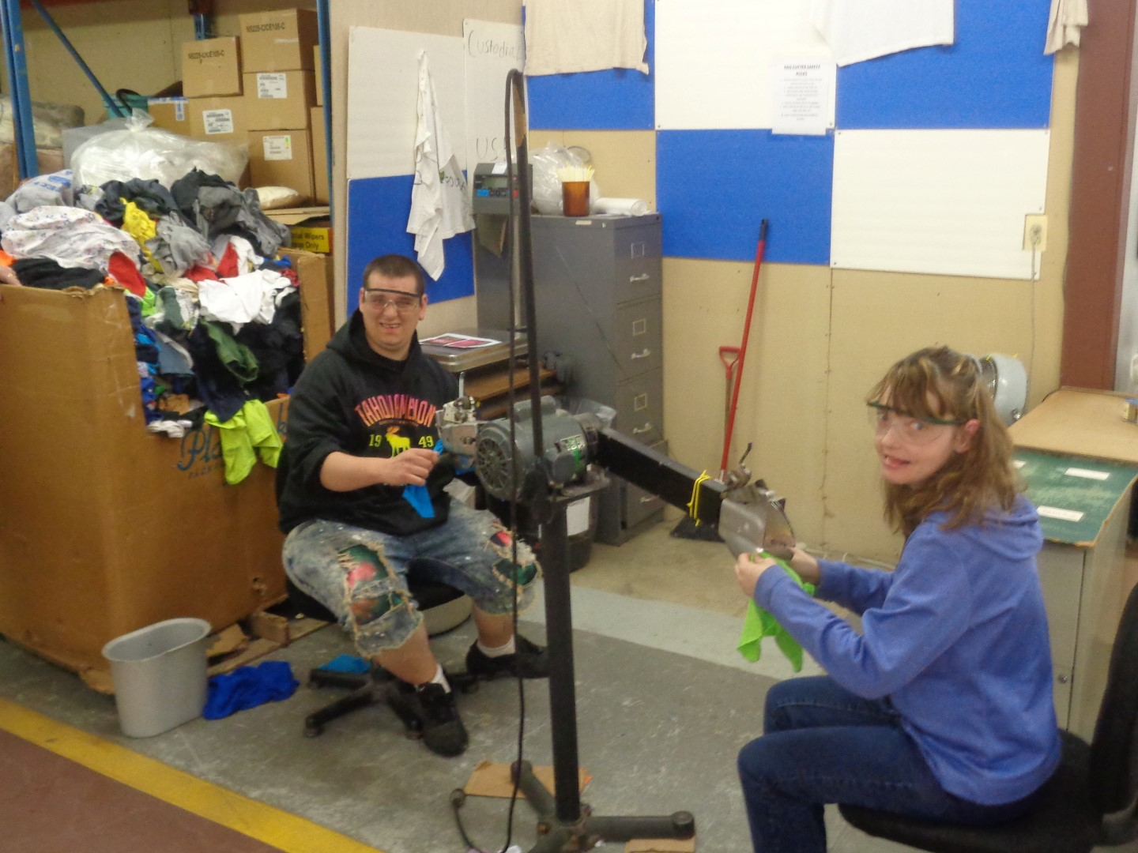
Stop !!
GIVE IT A NEW LIFE

Slide 12
Industrial Wipers
Goodwill makes Industrial Wipers out of clothing that has exhausted its wearable life
The Wipers are used by auto repair shops, manufacturing plants, utility companies.
Smaller quantities are also sold in our retail stores for home cleaning projects
This also creates jobs!!

Slide 13
Jobs and Recycling Go Hand & Hand

Slide 14
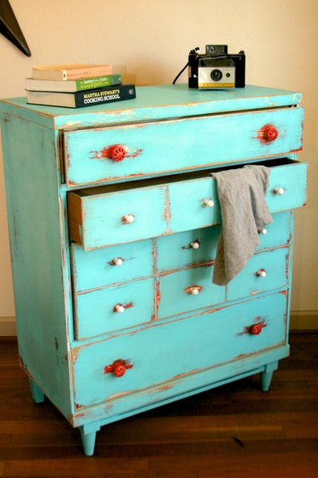
Give Old Tired Furniture New Life

Slide 15
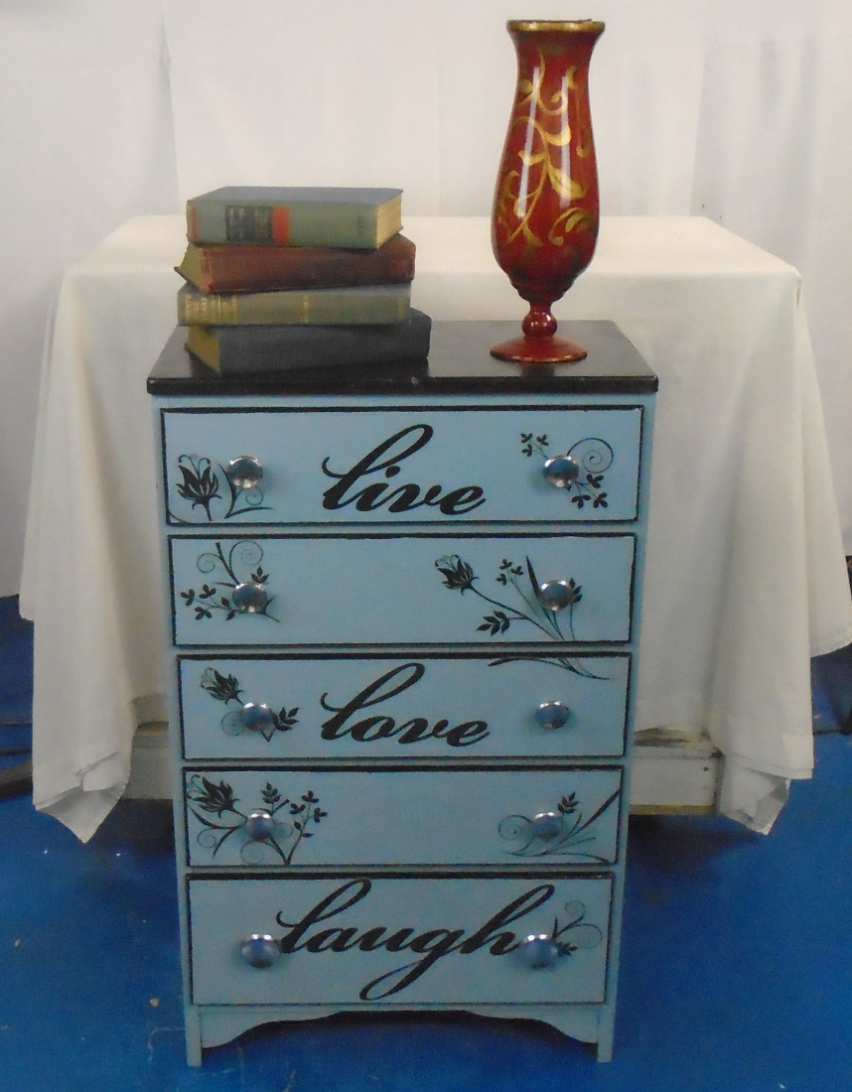
Up-Cycle!!
Enter for a Chance to Win !!

Slide 16
Earth Day is Every Day at Goodwill

